Slide 1
Send A
SALUTE Report
Presented By:

Slide 2
Task, Condition, and Standards
TASK: Report Intelligence Information using the SALUTE report.
CONDITIONS: You have observed enemy activity, significant
terrain and weather features and must immediately report the
activity to your chain of command via radio.
STANDARDS: Submit your observations in a spot report, using
the SALUTE format to your chain of command within 5 minutes
of observing the enemy activity.

Slide 3
SALUTE
SIZE: What is the size of the unit?
- # of personnel
- # of vehicles (highway, rail, etc.)
- # of equipment ( tents, weapons, etc.)

Slide 4
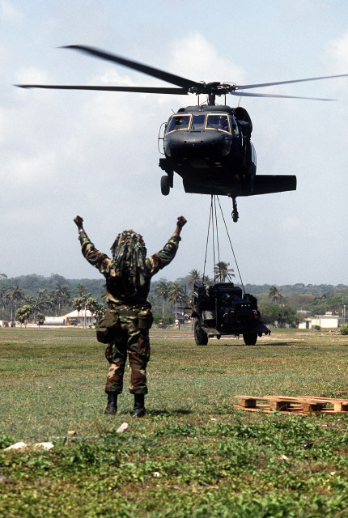
SALUTE
Activity: What are they doing?
- Deploying
- Redeploying
- Sustainment activities
- Training
- Defense

Slide 5
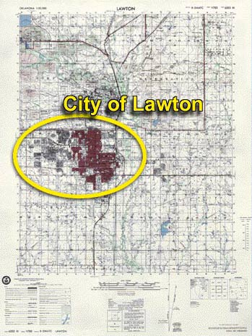
SALUTE
Location: Where are they located at?
- Grid Coordinates
- Airfield
- Military Base (OP, Kaserne, etc.)
- Terrain Association

Slide 6

SALUTE
Unit/Uniform: What unit do they belong to?
- Company
- Battalion
- Brigade
- Division
What Type of Uniforms do they have on?
- BDU’s
- MOPP Gear
- Special Ops Gear

Slide 7

SALUTE
Time: What time of day/night did you observe?
- DTG
- Zulu or Local
10 May 2001
1438(Z)
101438MAY2001
(Z)
101438MAY2001
(L)
10 May 2001
1438(L)

Slide 8
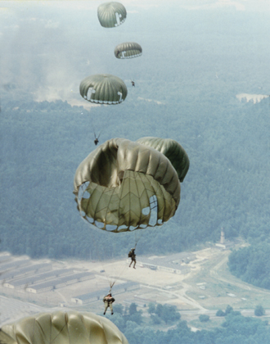
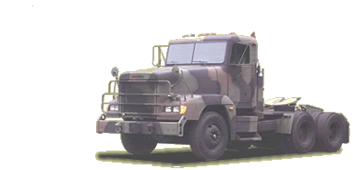
SALUTE
Equipment: What type of equipment did you see?
- Types of weapons (M16A1’s or M16A2’s)
- Types of Vehicles (Humvee’s, 5 Ton Trucks)
- Types of Aircraft ( AH-64’s, C-130’s)
- Types of Gear (Parachutes, Alice Packs)

Slide 9
Summary
Q: What does the “A” stand for in the acronym SALUTE?
A: Activity
Q: What are you looking for when filling out the “U” portion of the
acronym SALUTE?
A: The unit (Company, Battalion, etc.) and the uniform (BDU’s,
MOPP, etc.).
Q: What does the acronym SALUTE stand for?
A. Size, Activity, Location, Unit/Uniform, Equipment

